Slide 1
Applied Data Science Feature Engineering
Dr. Omri Allouche
2017

Slide 2
Homework
Read https://www.analyticsvidhya.com/blog/2016/01/guide-data-exploration/
Read https://www.quora.com/What-are-some-best-practices-in-Feature-Engineering/answers/5062347?srid=3dUC
Read https://www.analyticsvidhya.com/blog/2016/01/12-pandas-techniques-python-data-manipulation/

Slide 3

Coming up with features is difficult, time-consuming, requires expert knowledge. “Applied machine learning" is basically feature engineering.
- Andrew Ng

Slide 4
…some machine learning projects succeed and some fail. What makes the difference? Easily the most important factor is the features used.
- Pedro Domingos
“A Few Useful Things to Know about Machine Learning”

Slide 5
Create multiple categorical variables from a single variable
Some high cardinality features, like user-agents, hold far more information in them:
is_mobile?
is_latest_version?
Operation_system
Browser_build
Etc.

Slide 6
Coming Up with Features – Business Understanding
Ask business people what they think is predictive of the outcome
Some ideas might be anecdotal
Some might include data you don’t (currently) have available
Some might require an approximation of the ideal data described by the business people
Your job is to translate all of this into features.

Slide 7
RFMVT - Creating New Features
Recency. Signals how old certain event is.
Frequency. Signals how often does certain events occur.
Monetary. Any numerical representation of direct of indirect business value of an example.
Variety. How many distinct items are found for certain type of an example.
Tenure. How much time has elapsed since the first appearance of certain example or of an example of certain type.

Slide 8
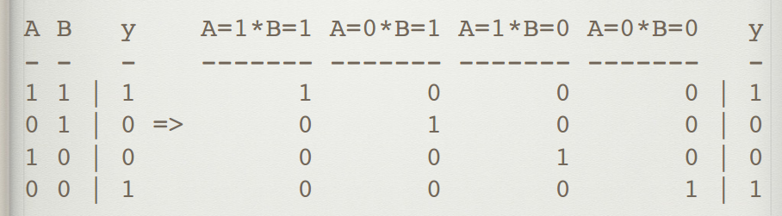
Interactions
Specifically encodes the interactions between numerical variables
Try: Substraction, Addition, Multiplication, Divison
Use: Feature selection by statistical tests, or trained model feature importances
Ignore: Human intuition; weird interactions can give significant improvement!
A polynomial kernel can solve XOR

Slide 9
Feature engineering Examples
is_null
Dummy variables
Make sure you don’t introduce colinearity
What to do if you have lots of different values?
What if the test data contains unseen values?
Notes:
Create dummy vars for common variables + shared value for rare variables

Slide 10
Features when grouping
E.g. we have data about purchases, we’re interested in data about customers
Number of rows
Average/median/mode/min/max/std etc.
Number of NaN’s
Number of 0’s
Number of negative values
For categorical data, nunique()
#/% of most common value
Entropy
Correlation between 2 columns

Slide 11
Trendlines
Instead of encoding: total spend encode things like:
Spend in last week
Spend in last month
Spend in last year
Gives a trend to the algorithm
Notes:
two customers with equal spend, can have wildly different behavior — one customer may be starting to spend more, while the other is starting to decline spending.

Slide 12
Coming Up with Features – Error Analysis
Review model errors (misclassifications)
Try to think why the model got these wrong
Look for insights that might lead to new ideas for features
Consult with people with domain expertise and business understanding

Slide 13
Circular Values - Projecting to a Circle
Turn single features, like day_of_week, into two coordinates on a circle
Ensures that distance between max and min is the same as min and min +1.
Use for day_of_week, day_of_month, hour_of_day, etc.

Slide 14
Additional Ideas
Closeness to major events
Closeness to Hubs
Cluster using an unsupervised method and use the cluster number
String Manipulations

Slide 15
Importance of Feature Engineering
You are given the company’s revenues and expenses. Using a decision tree, determine is the company profitable?

Slide 16
Problems with Feature Engineering
Feature Explosion
The Curse of Dimensionality
Longer training times
Larger memory requirements
Less interpretability
Potential of overfitting
How can we handle these?
Notes:
regularisation, kernel method, feature selection

Slide 17
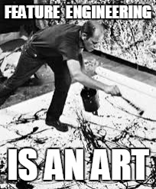

Slide 18
Kobe Bryant’s Shots https://www.kaggle.com/selfishgene/kobe-bryant-shot-selection/psychology-of-a-professional-athlete http://adataanalyst.com/kaggle/kaggle-tutorial-kobe-bryant/
Open Discussion

Slide 19
e-Commerce Site Analytics
Open Discussion

Slide 20
How to measure what we want?
eCommerce Analytics
Market Basket Analysis
Transaction Fraud
Customer churn
Customer satisfaction

